Slide 1
The History of the European Union
1957 - 2022

Slide 8
9. Mai 1950: he made a revolutionary proposal: The European Nations should work together closely to build up their industrial economies.

Slide 9
25. März 1957 (two days later I was born!) the Roman treaties establishing the EEC were signed.
The European nations BE, DE, FR, IT, LU, NL (three large and three small) form the nucleus of the EU.

Slide 11
The first big crisis for the young EU, but world peace is more important than the freedom of East Germans.

Slide 12
Turkey would like to be the first country ever to join the European Union. The answer:
You get an association contract, but no membership. Nothing has changed until today.

Slide 13
In many European countries, the young generation is revolting against the dominance of the old war generation,
They demonstrated in a lot of countries for more democracy.

Slide 14
In the Eastern European countries, young people want more democracy, but the Soviet Union is using tanks to stop this.

Slide 15
In the West of Europe, more and more young people are traveling.
They get to know the other Europeans better and celebrate the motto of the
European community "United in diversity".

Slide 16
Only 16 years after the foundation we had the first expansion:
UK, IR, and DK want to join the community. Now there are 9 countries.

Slide 17
The 1970s are finally marked by more democracy.

Slide 18
A peaceful revolution in Portugal

Slide 19
The young King of Spain makes a peaceful transformaton from fascism to democracy.

Slide 20
Since 1979, every five years the citizens of the EU have voted in general, direct, free, secret European elections.
This makes the European Parliament the only directly elected supranational institution in the world.

Slide 21
Something is happening in the East of Europe too, but it will take another decade to change things not only in Poland.

Slide 22
Almost thirty years after the start of the European community,
three southern European countries are joining: GR, PT and ES. Now: 12 nations.

Slide 23
Erasmus is expensive but good! The youth of Europe get to know each other better.

Slide 24
The Baltic Way
1989
The period of national movements in the Baltics from 1987 to 1991 is called the Singing Revolution
and the non-violent struggle to regain state independence.

Slide 25
Craaaazzzyyyy!

Slide 26
Reunification of East and West Germany. Great joy and great fear of a Germany that is too big!

Slide 27
The North of Europe also wants join the EU:
SE, FI and Austria. 15 states! Norway and Switzerland don't want to join, they're too rich for solidarity.

Slide 28
A shock: war in Europe, 50 years after the end of the world war II – and then an extremely brutal civil war.

Slide 29
Now it's getting serious, we don't just share a few values, but the money is becoming European.
Not everyone participates, some want their independence, others are not economically stable enough.
But things are getting much easier for travelers like us.

Slide 30
Unbelievable - after the end of the Soviet Union and Warsaw Pact
10 new countries are joining the EU: EE,LV, LI, PL, CZ, SK, HU, SL and the islands CY, MT. Now: 25 states

Slide 31
More cooperation - the four freedoms: people, money, products and services. The EU is now:
economically a peaceful great power, has more population than the US and Russia together, but is militarily a dwarf.

Slide 32
We celebrate ourselves!

Slide 33
25 + 3 = 28 Romania, Bulgaria and Croatia also want to be part of it.
So far the EU has been mainly concerned with itself and its growth, now many problems come from within and without.

Slide 34
Remember: how old have you been in 2013? For 56 years the European Union was a success story.
From 6 to 28 members: peace, freedom, prosperity for so many citizens. Well done! But then …

Slide 35
Hungary on a confrontational course since 2010
Since his election as prime minister in 2010, Orbán has been accused of
restricting systematically human rights in Hungary.

Slide 36
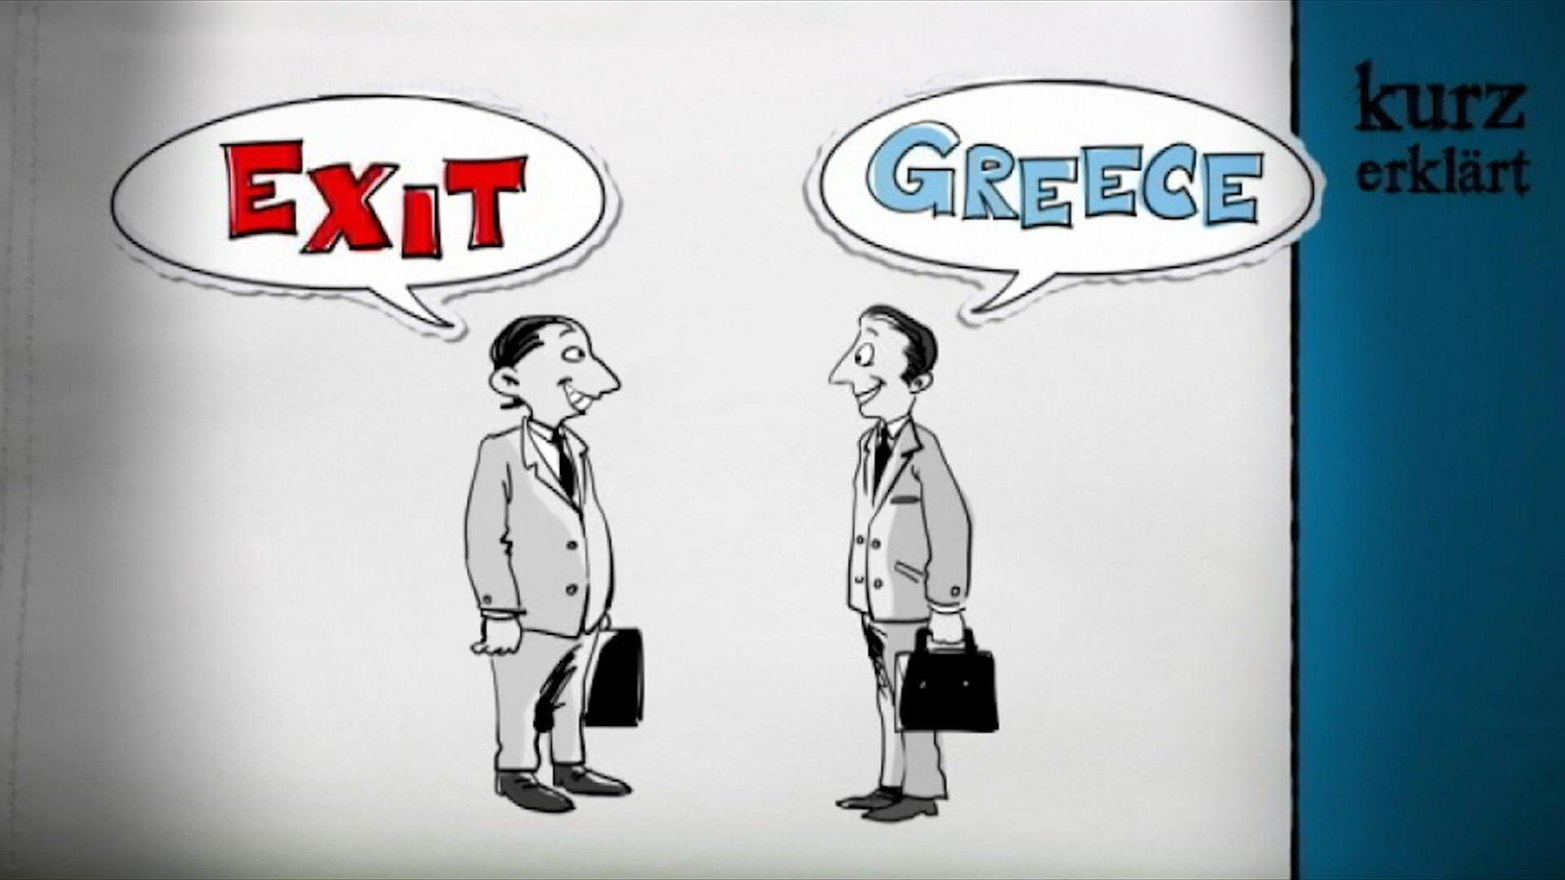
The euro crisis is a crisis in the European monetary union that started in 2010 for several years.
It includes a debt crisis, a banking crisis and an economic crisis.
The term "euro crisis" does not refer to the external value of the euro, as this has remained relatively stable.

Slide 37
Maidan 2013 and
The Ukrainians also want democracy for their country and the security of the EU.
Other Ukrainians welcome Russia's occupation of Crimea.

Slide 38
And again war. Not in Europe, but it affects us, the world is getting smaller. How similar the pictures are.

Slide 39
War produces refugees. The refugee crisis was not solved in solidarity.

Slide 40
Refugees 2015
The Italians, Spaniards and Greeks are left alone with the boat people for a long time.

Slide 41
Refugees 2015
On foot on the Balkan route to the EU

Slide 42
Borders 2015
Europe builds borders again.

Slide 43
Poland 2015
Under the PIS party, Poland is becoming a problem for the rules of law in the EU.

Slide 44
This can't be true, the Brits are OUT. Not from the World Cup, but from the EU. Unbelievable!!!

Slide 45
Greta Thunberg is trying to shake the world public, our earth is in danger. The EU prefers to wait.

Slide 46
An unexpected or expected attack on our health, the EU behaves in solidarity but not as one.

Slide 47
War 2022
A war outside the EU with many implications for the EU.

Slide 48
A turbulent and moving story without happy end. That was the past! How to proceed?
1957 - 2022

Slide 49
What do you expect from the EU for your FUTURE?

