Slide 1
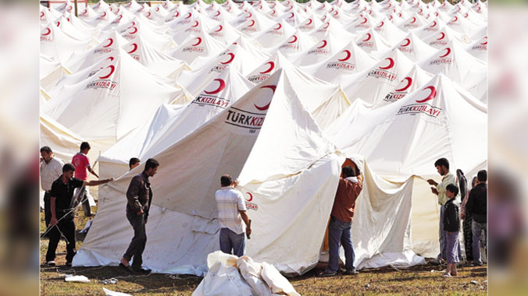
The Most Important Problems of Refugees

Slide 2
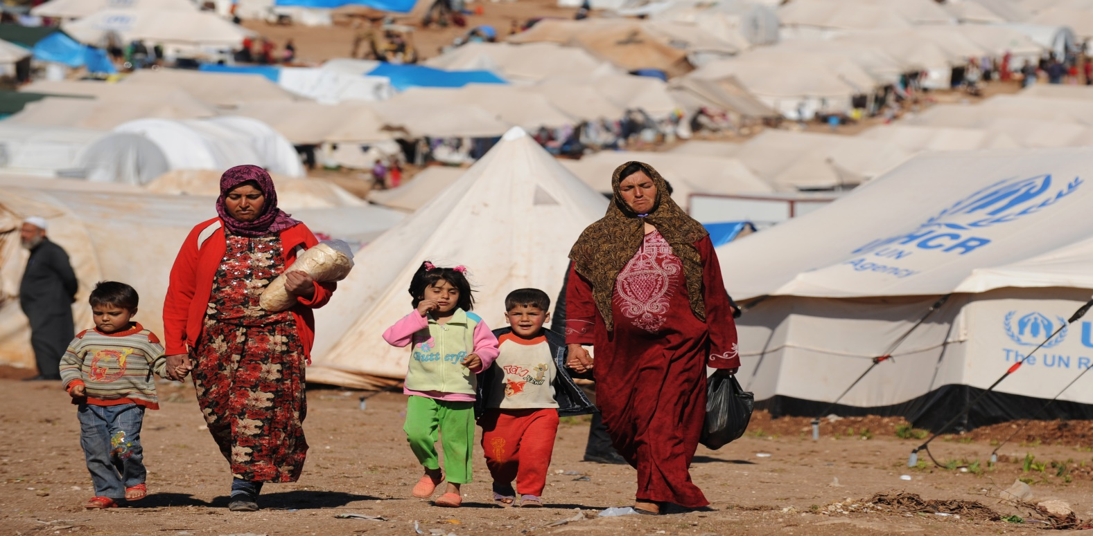
Nejmettin Bingöl: Refugees mobility in our country due to Turkey's geographic location has been often experienced from the past. This situation brings the importance of the concept of refugee problems. The biggest and most fundamental problem they have experienced is that they are separated from their geographies for some reason and forced to migrate to other geographies. In the regions where they go, they cannot keep up with the culture, customs and traditions of those lands. This couses many problems.

Slide 3
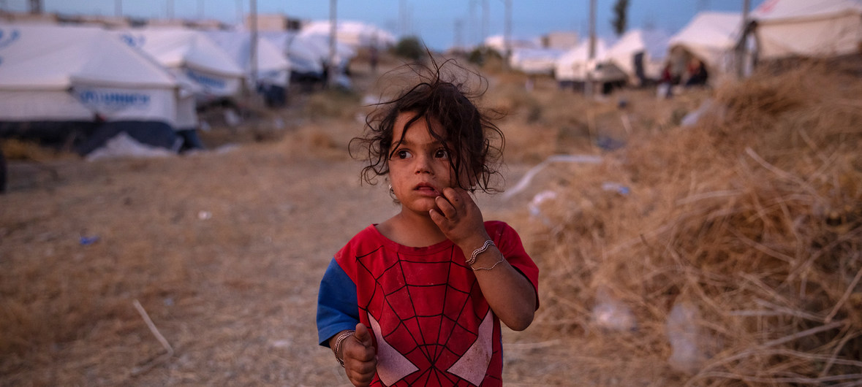
Gökhan Çelebi: Refugees, huge group of people while they are earning their life, goverments face lots of problems. They see these people who take refuge in his country for compulsory reasons as cheap labor. Refugees' labor is exploited. For example, Syrians have turned into “a cheap labor ”sources in many places.

Slide 4
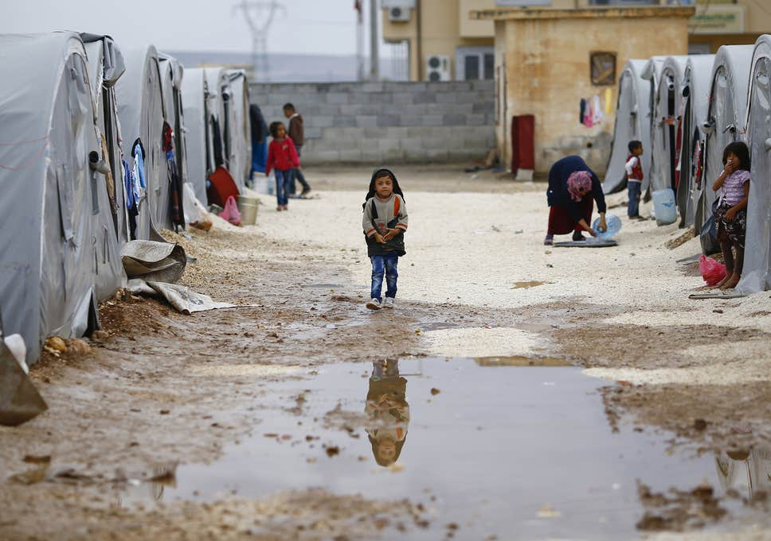
Hüseyin T. Kanber: Education is one of the most important problems for refugees. Especially thousands of children who do not have access to education are regarded as missing generations. They cannot adapt to the education system of the country which they came from due to compulsory reasons. Many parents refrain from sending their children to educational centers. The countries that accept the refugees take the necessary measures to prevent this generation from disappearing, but they are caught in the parental barrier which is the other and most important part of education. Turkey, for example by opening the TTC (temporary training centers) for Syrian refugees is trying to include these children in education.

Slide 5
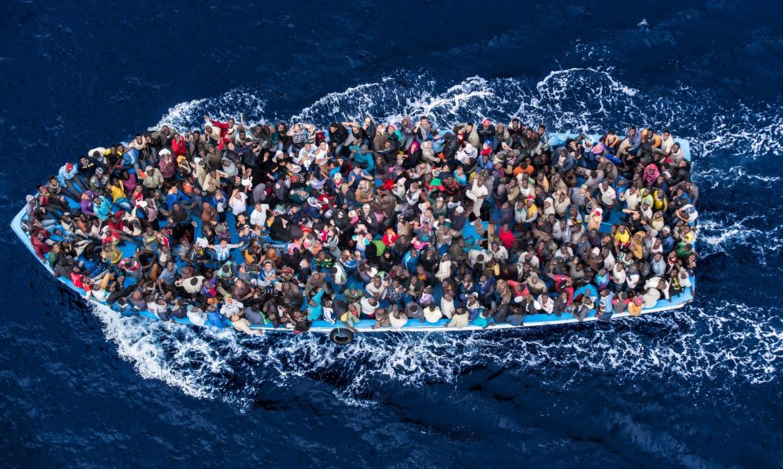
Dursun Atik: Refugees are trying to live together with the people of the country they live as a refuge. This kind of living leads to some problems. Local people of the country where they live can treat second class people to refugees.
Refugees do not accept the local people and the local people do not accept the long-term permanence of the refugees. The prolonged asylum rights of refugees in particular cause local people to take a negative attitude towards them. Against this, we witness the emergence of a great concept such as “xenophobia”.

Slide 6
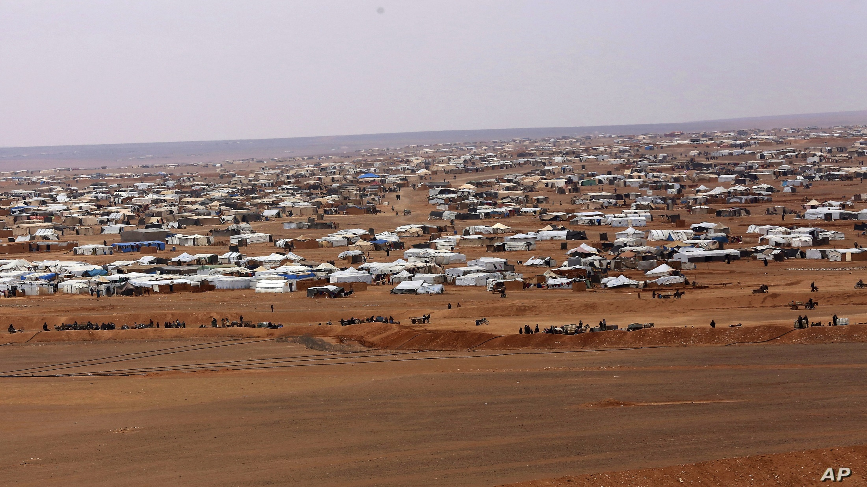
İdris Aslan: One of the biggest problems of refugees is increasing of population. There is np planning of population in the countries where they immigrated. This situation suddenly leads to population growth and serious problems are supplied in fulfilling the basic needs of this population. In addition, children born in these countries do not feel belonging to the country in which they live or the country of their parents. They stagger between two cultures.

Slide 7
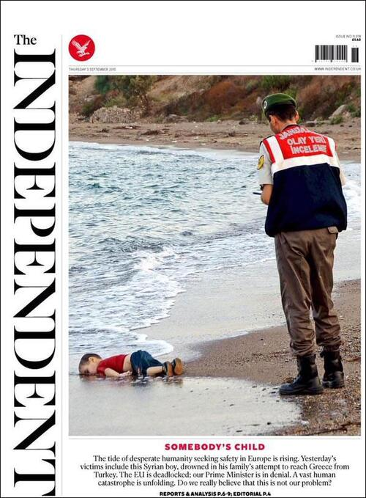
Sercan Şimşek: Since the day the world has existed, human problems have ocurred. Refugee is one of them. These people, who have been taken away from their countries, cannot integrate to the places they can barely go to. Although they all have the concept of human in denominator, they face the problem of adaptation because their language, religion, race and geography are different. The local people who they immigrate as a guest, somehow cannot adopt them. In addition, refugee children who lost one of their parents for various reasons suffer traumatized by many ugly problems. some are being abused, some are falling into the hands of human traffickers, and some are vanishing by sacrificing themselves for illegal activities.

