Slide 2
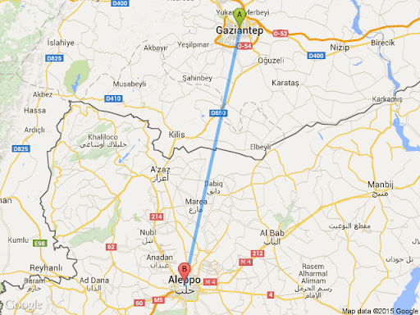
Twin Cities
Gaziantep and Halep (Aleppo)

Slide 3
Do you know how far away is Gaziantep from
Aleppo?

Slide 4
Aleppo is only about 100 kilometers from Gaziantep.
Aleppo is far nearer to Gaziantep than most of the cities in Turkey.

Slide 5
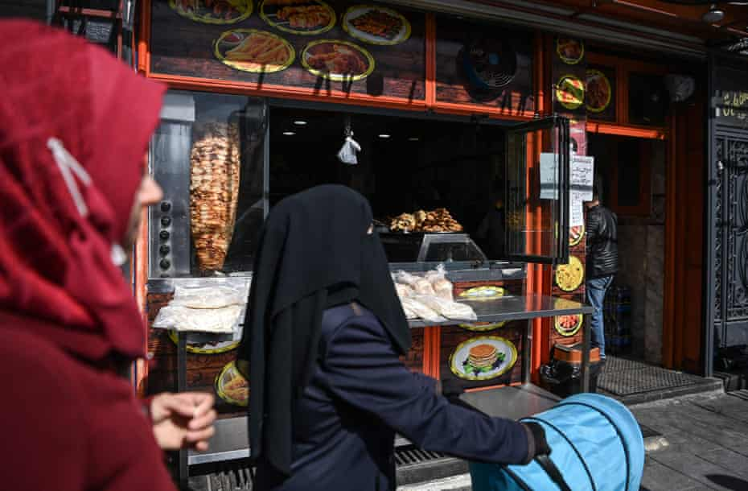
The twin ancient and trading posts share many cultural and historical ties.

Slide 6
About 10 years ago, there were taxis from
Aleppo waiting in line at the Gaziantep airport.
Why? Just to take their customers back to
Aleppo.

Slide 7
The taxis from Aleppo used to bring them
to the airport and then take them back.

Slide 8
The twin cities met and kind of liked
each other.
Everything was moving in the right
direction.

Slide 9
How has everything chaged at one night and
became like a badly directed bloody horror
movie?

Slide 10
The Civil War

Slide 11
https://youtu.be/K5H5w3_QTG0

Slide 12
Syrians fled their country to escape the horrors of the now 10-year-old war to the first closest,safe and place:Gaziantep

Slide 13
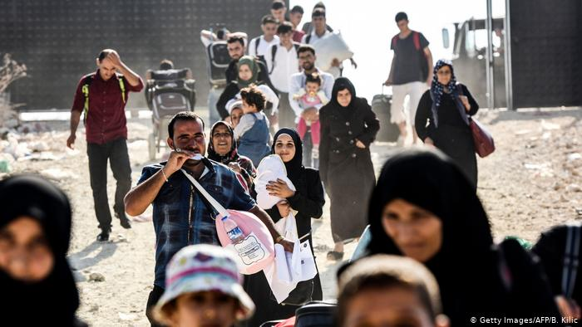
Gaziantep is the centre of this new reality for both Syrians and Turks.
Our city hosts about half a million Syrians “refugees”.

Slide 14
Gaziantep Municipality has determINED five main TITLES to handle “Refugee Crisis” :

Slide 15
1. Education: integrating “refugee” children into Turkish schools
2. Health: minimizing the mother and new-born death rates
3. Language: Turkish courses for women, children
4. Employment: 25 % “refugee” employment requirement.
5. Social harmonization

Slide 16
Turkey and Refugees

Slide 17
Turkey is home to the world’s largest “refugee” population, currently 3.7 million Syrian refugees, in addition to about 300,000 Afghans.

Slide 18
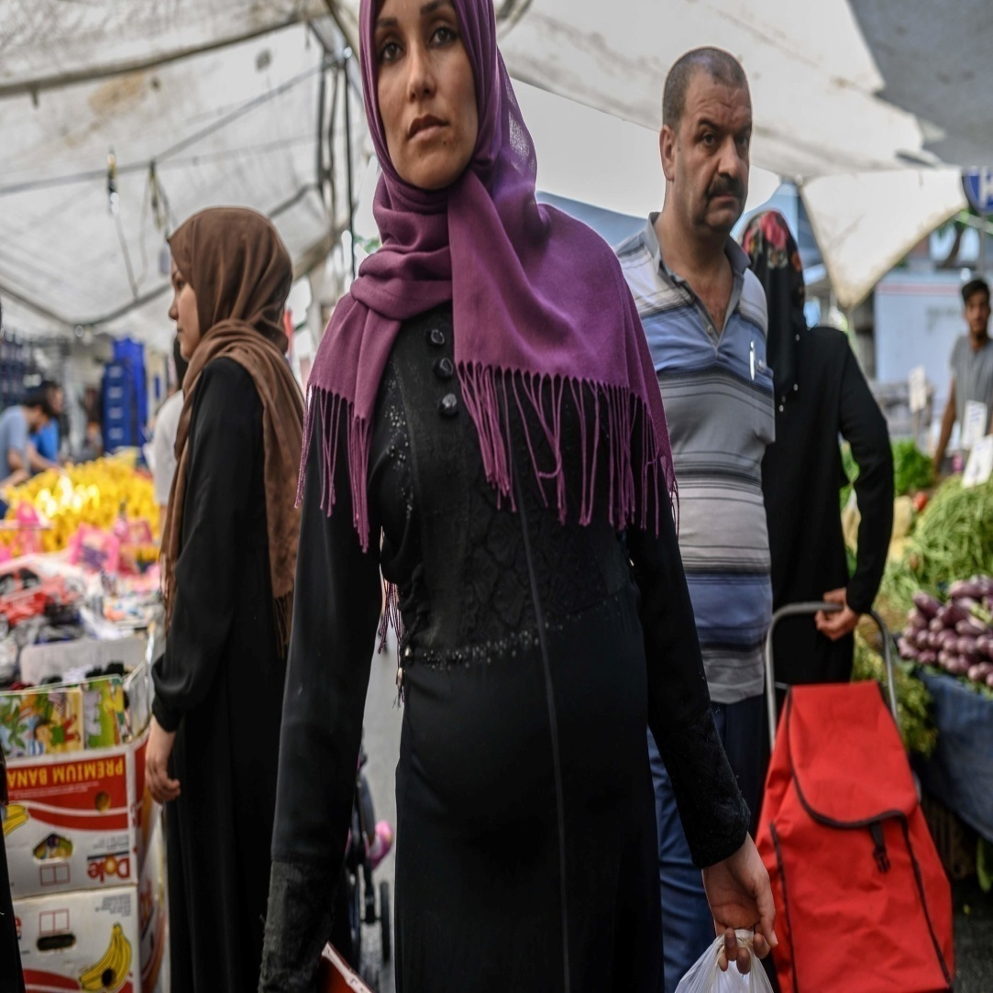
Over 98 per cent of “refugees” in Turkey live among the host community, and less than 2% in Temporary Accommodation Centres.

Slide 19
In Turkey at least 110,000 of “refugees” have already obtained Turkish citizenship and about 500,000 Syrian children have been born here since the crisis began.

Slide 20
Life is still far from easy for Syrians in Turkey, but it is better than other host countries, where “refugees” are mostly denied the right to work or integrate into society.

Slide 21
New Influx of Refugees

Slide 22
Unfortunately, now the world is facing with a wave of Afghan “refugees” following the Taliban’s takeover.

Slide 23
https://youtu.be/jxEA9DvGrn4

Slide 24
Somewhere between 500 and 2,000 Afghan
refugees are now estimated to be trying to enter
Turkey every day after undertaking the long and
unbearable journey from Afghanistan.

Slide 25
A refugee is someone who has been forced to flee his or her country because of
persecution, war or violence.
A refugee has a well-founded fear of persecution for reasons of race, religion, nationality, political opinion or membership in a particular social group.

Slide 26
As Turkey, we have sufficiently carried out our moral and humanitarian responsibilities regarding migration and as the host community, we continue to do so.

Slide 27
“Refugee” is a world problem not just one or a few countries’ issue. Every indivual, every mother, every teacher, every school, every city, every country has her/his own part to handle this crisis.

Slide 28
Either all for better otherwise all worse.

Slide 29
Thank you for listening …

