Slide 1
Some thoughts about
Walls and Borders

Slide 2
1. chapter: Germany and its walls 2. chapter: Germany and its borders 3. chapter: Germany and the refugees

Slide 3
1. chapter
Walls

Slide 4
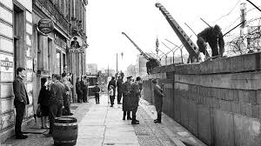
BERLIN‘61
Walls
This was a crazy situation.
One day in August 1961
workers start to build a wall right through the middle of Berlin.
Guarded by soldiers.
People couldn‘t believe
their eyes.

Slide 5
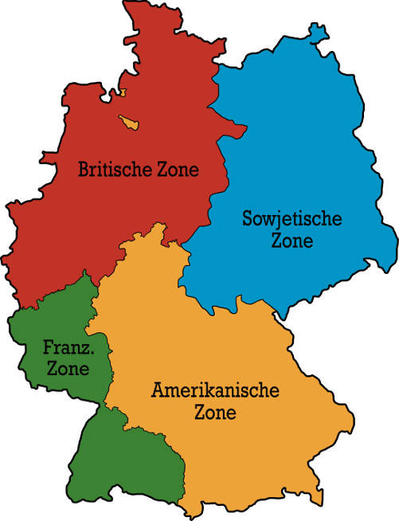
Why?
Walls
1945
1949
Two countries with controlled but open borders

Slide 6
Why?
Walls
1949 - 1961
1961
to STOP the escape of more and more people from East to West

Slide 7
And then?
Walls
A successful escape meant a life in freedom.
A failed escape meant death or prison.

Slide 8
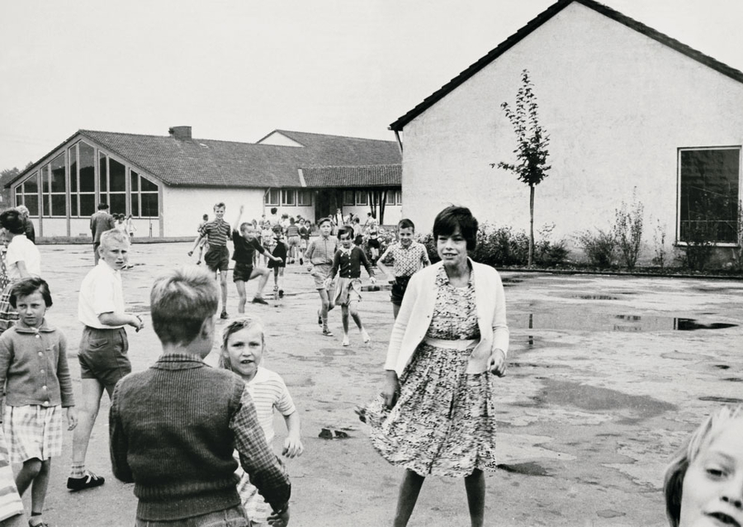
And the lucky refugees?
Walls
Refugees from East to West came for a short time to a camp like Unna-Massen in NRW. They got a West German ID, money and start-up help. They were welcome.
Helpers of refugees were heros, in the West and criminals in the East part of Germany. But not only Germans came to Germany, in the camp Unna- Massen - responsible for NRW - 2,4 million people from 100 countries get help to settle down in NRW until now.

Slide 9
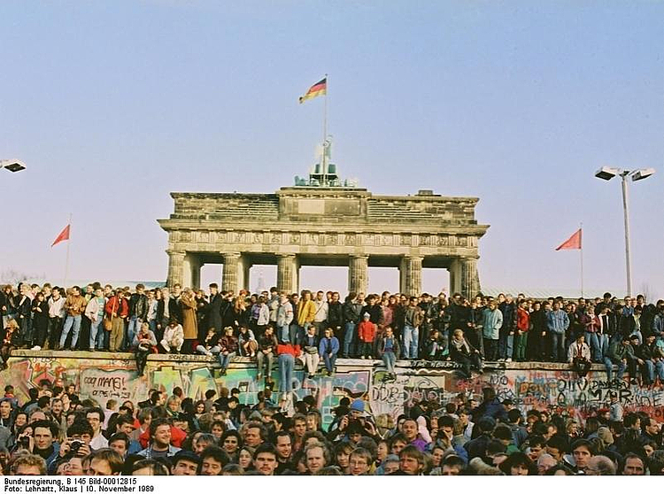
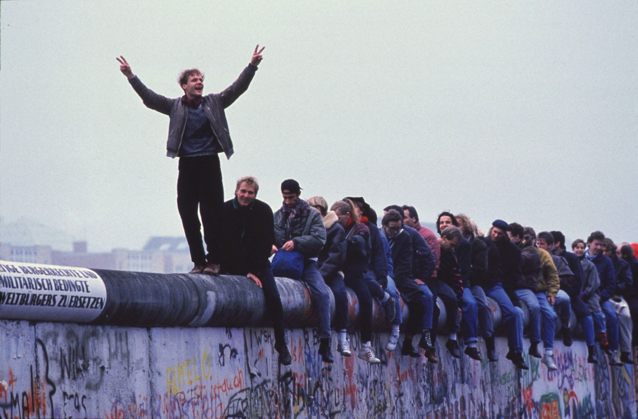
Berlin‘89
Walls

Slide 10
We – the Germans – are experts in matters of walls.
Walls

Slide 11
Any questions?
Walls

Slide 12
2. chapter
Borders

Slide 13
Germany and its neighbours
Borders
A lot of our neíghbours
had been
enemies in World War I and II
and some of them were the founding members of the EU in 1957.

Slide 14
Schengen Agreement 1990
Borders
All of our neighbours
are now friends. Look at the special location of Germany in Europe.
There are no
longer any
borders or
border controls.

Slide 15
European Single Market 1993
Borders
The "Four Freedoms"

Slide 16
We – the Germans – are experts in a life without borders.
Borders

Slide 17
Any questions?
Borders

Slide 18
3. chapter
Refugees

Slide 19
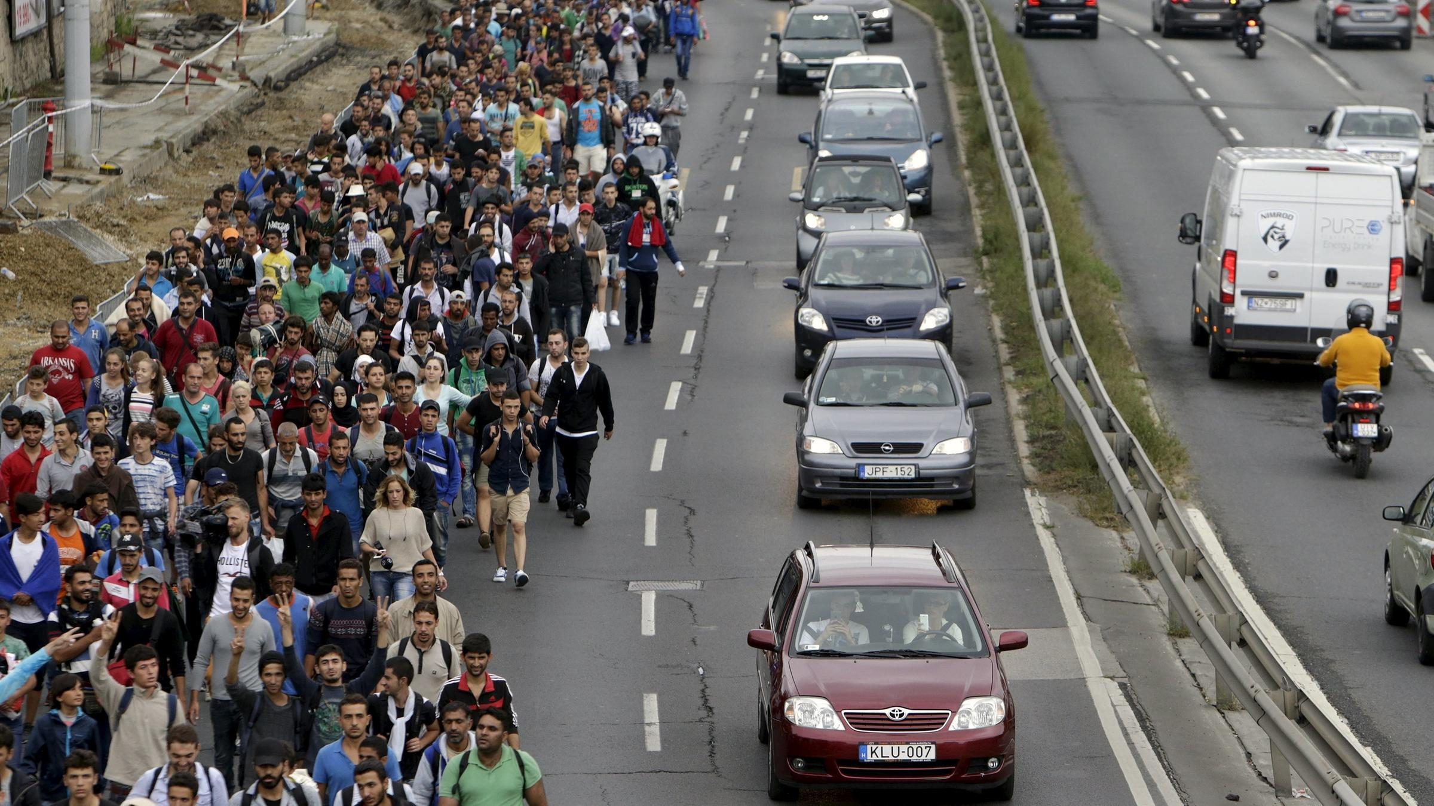
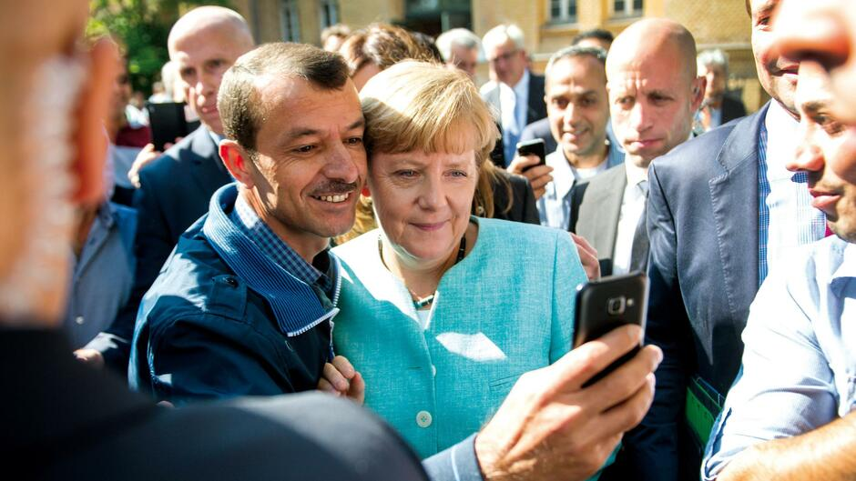
2015 Angela Merkel Wir schaffen das!
Refugees
Yes, we can!

Slide 20
The rest of Europe thought that we are crazy!
Refugees

Slide 21
Schengen –Area
Refugees
Germany has no borders to countries
who are not in the EU. No external borders!!
Usually the refugees should stay in
the country they reach first.
That is unfair. Germany takes over a lot of refugees to help those countries with external borders. There is no consensus to distribute refugees equally across the EU.

Slide 22
Fortress Europe
Refugees
Some people use the term as a negative description of the state of immigration into the European Union.
For some people 'Fortress Europe' is a positive term, because it means that we are save within our borders.

Slide 23
Border control and building walls is up-to-date again!
Refugees

Slide 24
Which new walls do you know?
Refugees

Slide 25
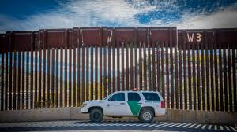
NOW!
USA - Mexico

Slide 26
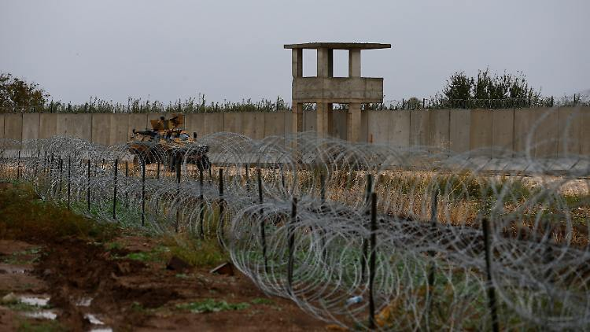
NOW!
Turkey –
Syria/Irak

Slide 27
NOW!
Hungary - Serbia

Slide 28
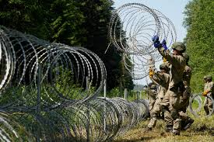
NOW!
Belarus –
Lithuania

Slide 29
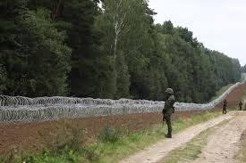
NOW!
Belarus –
Latvia

Slide 30
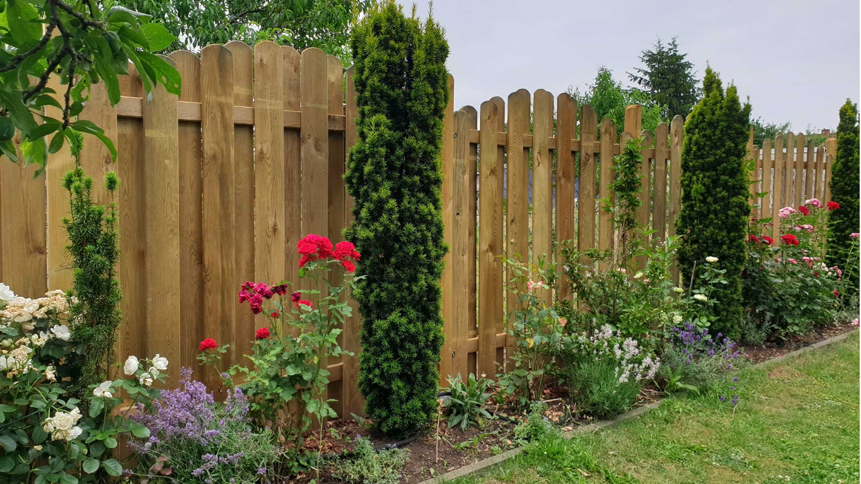
NOW!
The neighbourhood fence.
Isn't it normal to put up fences?

Slide 31
NOW!
Can you imagine a life in a world without walls and borders?

Slide 32
NOW!
What life would you prefer?
With borders or without borders?
How do we treat people who have crossed the border and want to stay in our countries?

Slide 33
NOW!
Discuss this in mixed groups of teachers and students and of Bulgarians, Turks and Germans
Thank you for listening so much!!!

